Slide 1
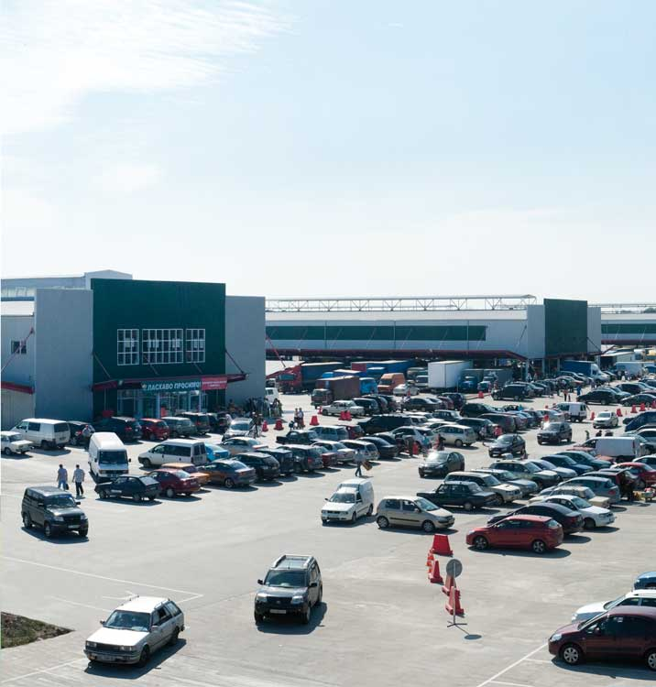
Wholesale Market of Agricultural Products Chain of Ukraine

Slide 2
Mission
We are Ukrainian company called by time and by necessity of creation civilized market of agricultural products.
We make substantial producers of agricultural products while ultimate customers receive accessible for the money high quality products.

Slide 3
Strategy
Export to the regions
on the platform WAP
“Truck train” project
Consumption in region
Supermarkets
Retail markets
-Stalls
Shops “Near the house”
HoReCa
Export
WMAP
Producers:
Grant of place at the market
Platform shelter
Certificate of prices
Booking of places
Card of permanent customer
Cooperation with village council
Project “Delivery”
Project “Distance sales”
Project “Intellectual logistic»
Import
Bringing in the best importers on
WAP
Creation of conditions
for attraction world importers
Project «Truck train»
Project «Intellectual logistic»

Slide 4
The WMAP chain will be built in a few stages.
The state program of development of
WMAP chain in Ukraine is scheduled
on the period of 2010-2015.
Legal framework
The construction and the functioning of WMAPs will be realized Law of Ukraine “About the wholesale markets of agricultural products” ¹ 1561-VI from 25.06.09;
“The state special program of development of the whole sale markets of agricultural products” ¹ 562 from 03.06.09;
Other regulatory legal acts of current legislation of Ukraine.

Slide 5
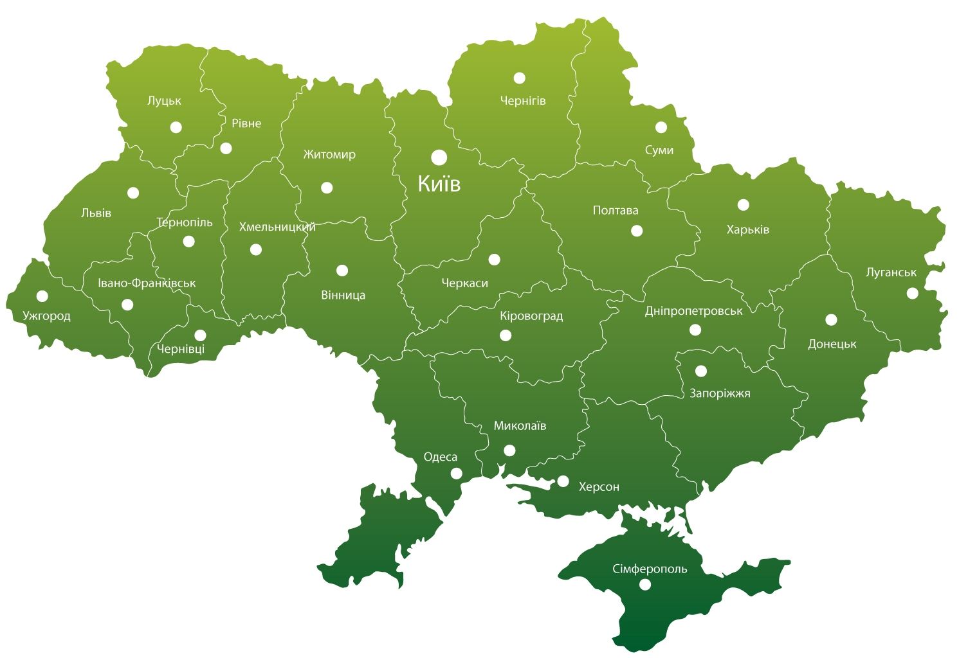
WMAP CHAINE 2012

Slide 6
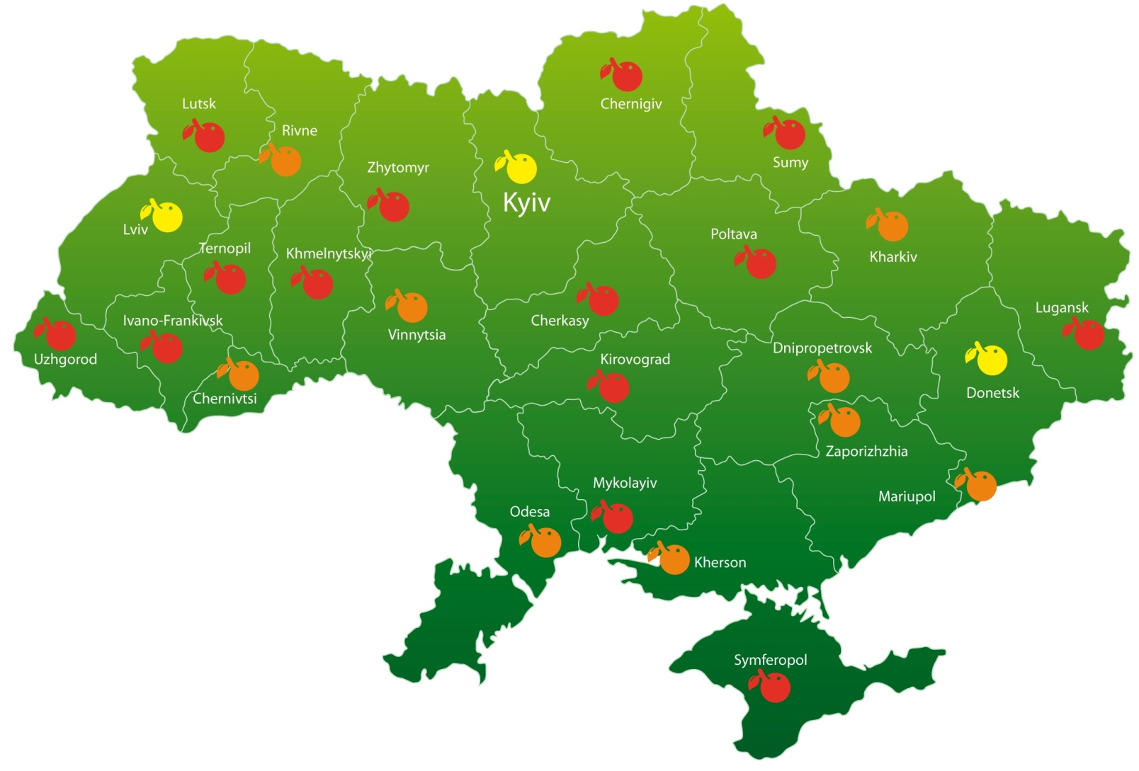
WMAP 2011
WMAP 2012
WMAP 2015

Slide 7
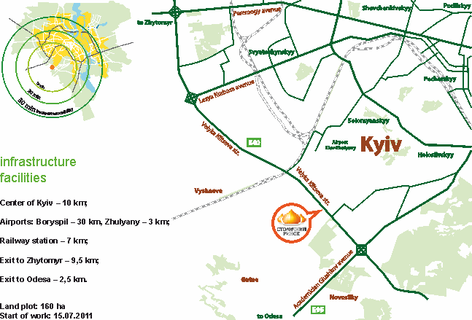
WMAP «Stolychnyy» Kyiv

Slide 8
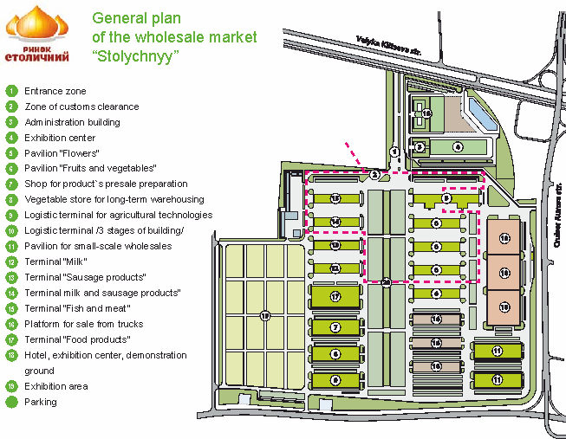
WMAP «Stolychnyy» Kyiv

Slide 9
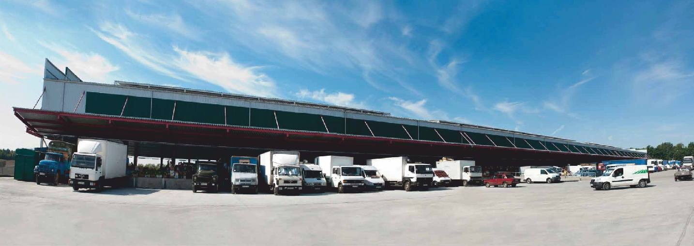
WMAP «Stolychnyy» Kyiv

Slide 10
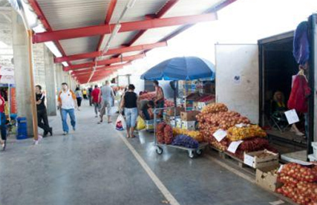
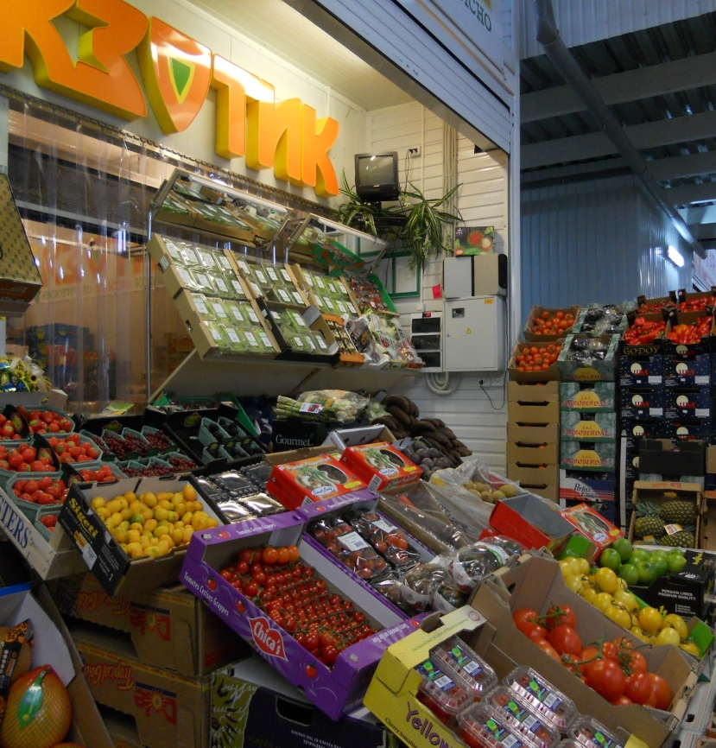
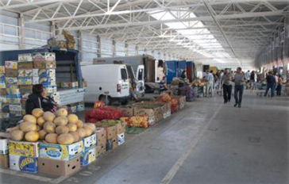
WMAP «Stolychnyy» Kyiv

Slide 11
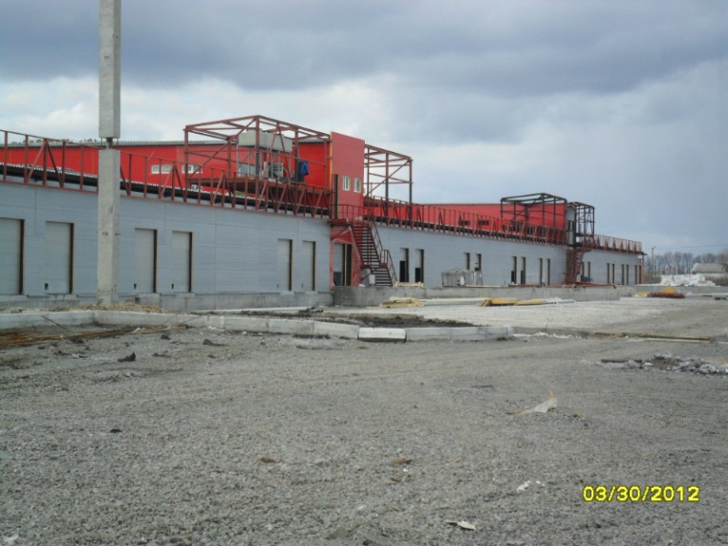
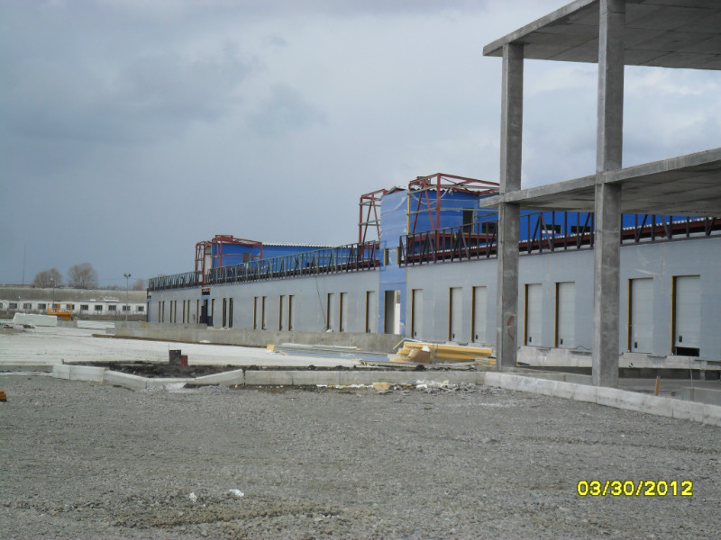
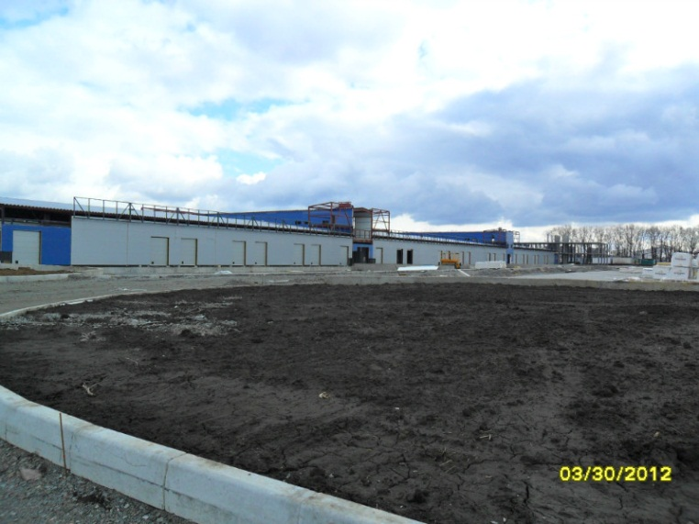
WMAP «Stolychnyy» Kyiv

Slide 12
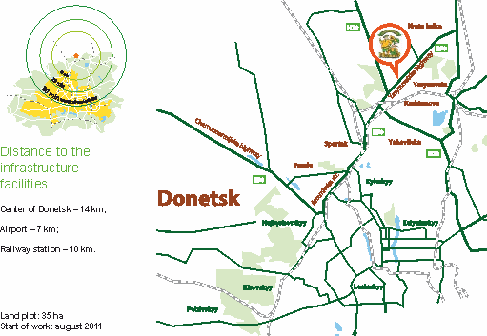
WMAP«Gospodar» Donetsk

Slide 13
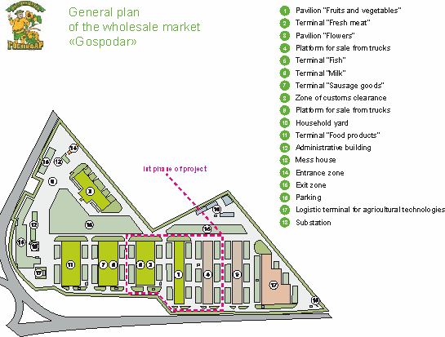
WMAP«Gospodar» Donetsk

Slide 14
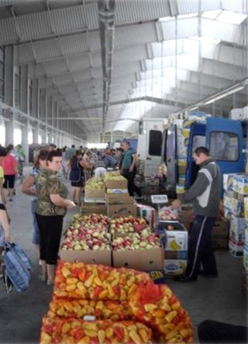
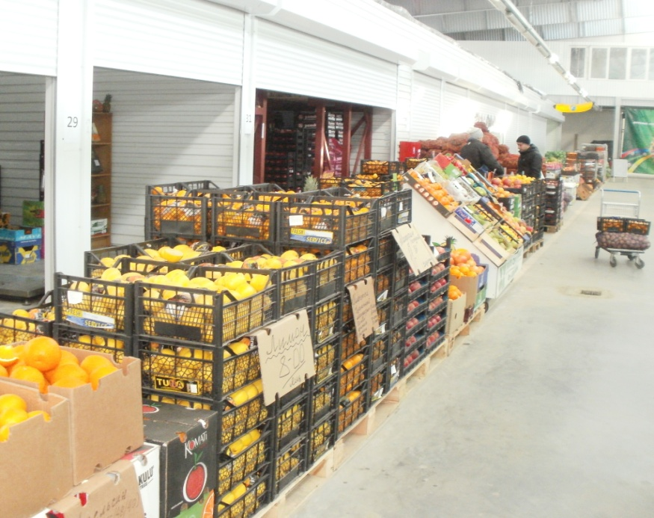
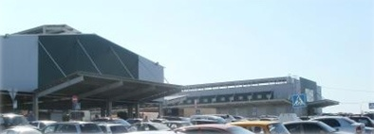
WMAP«Gospodar» Donetsk

Slide 15
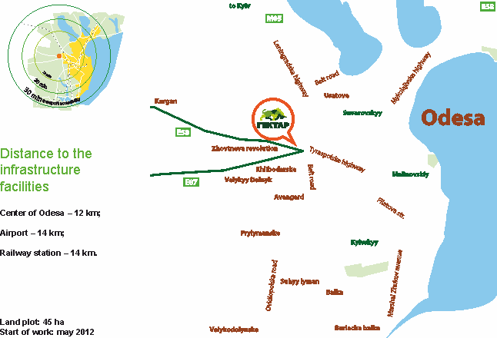
WMAP «Hectare» Odesa

Slide 16
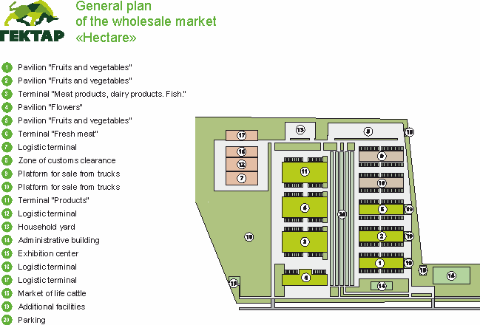
WMAP «Hectare» Odesa

Slide 17
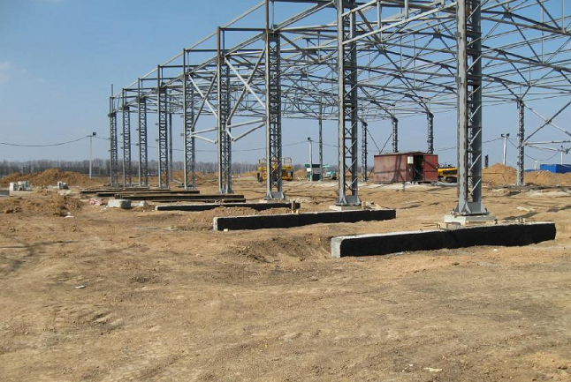
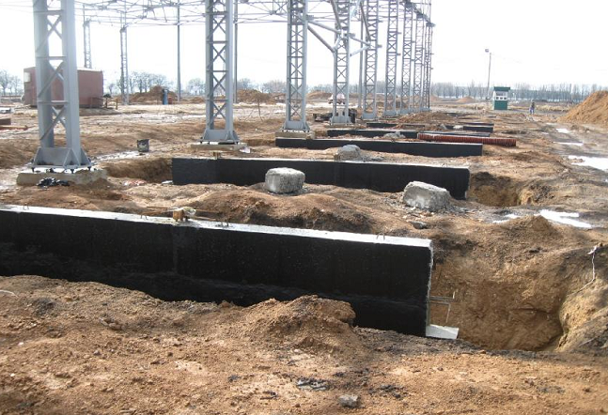
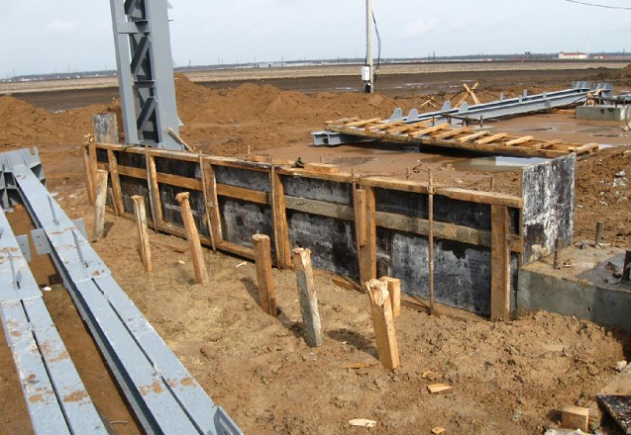
WMAP «Hectare» Odesa

Slide 18
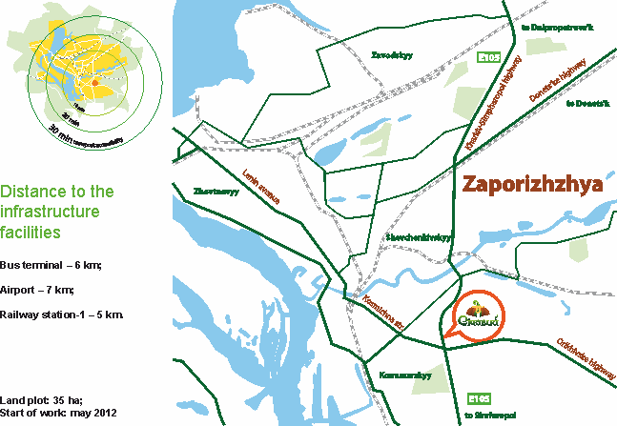
WMAP«Sichovyy» Zaporizhzhya

Slide 19
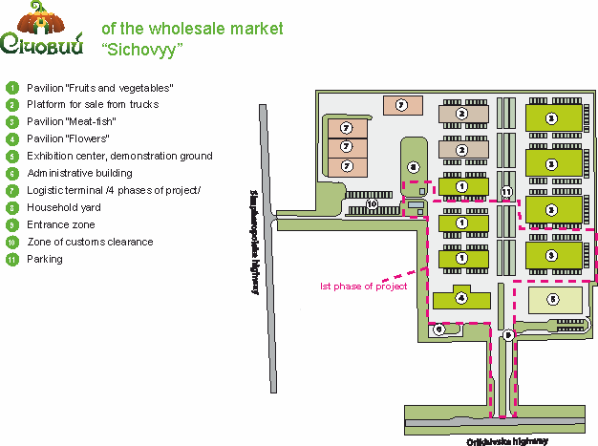
WMAP«Sichovyy» Zaporizhzhya

Slide 20
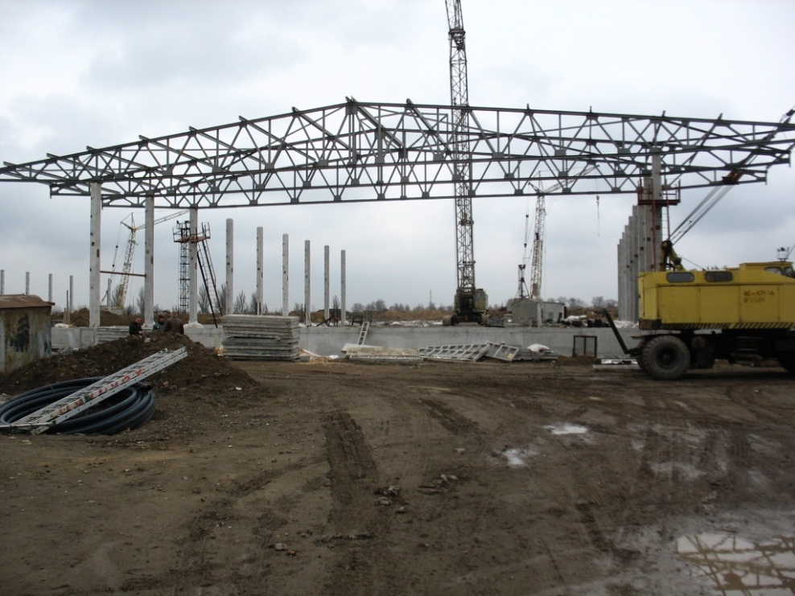
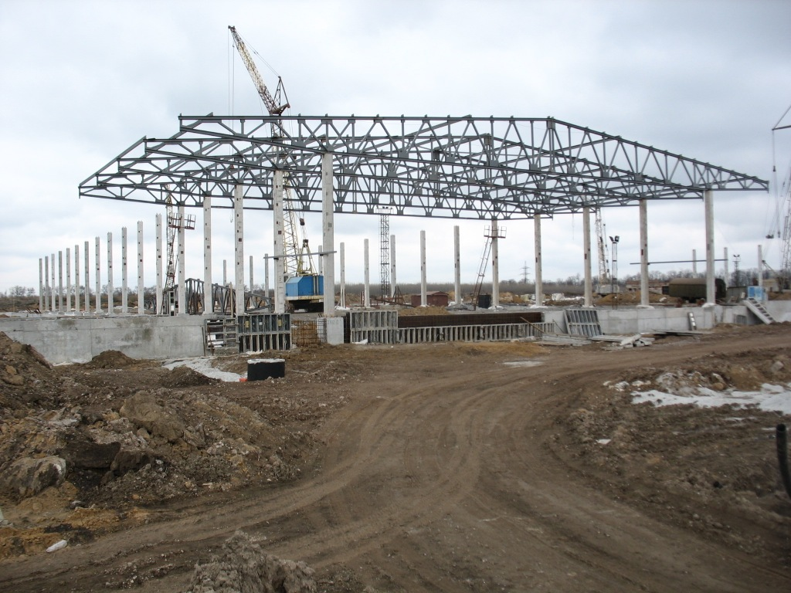
WMAP«Sichovyy» Zaporizhzhya

Slide 21
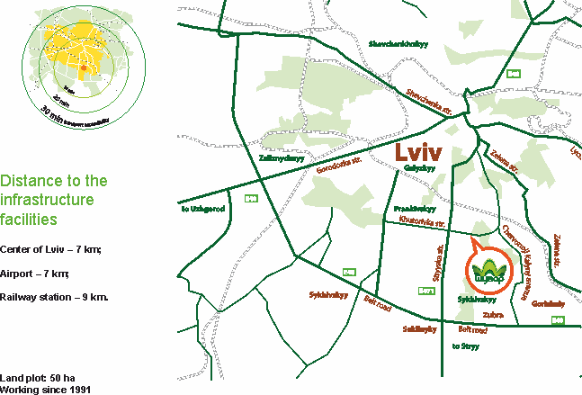
WMAP«Shuvar» Lviv

Slide 22
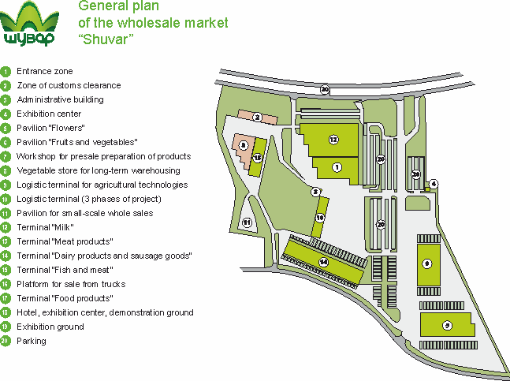
WMAP«Shuvar» Lviv

Slide 23
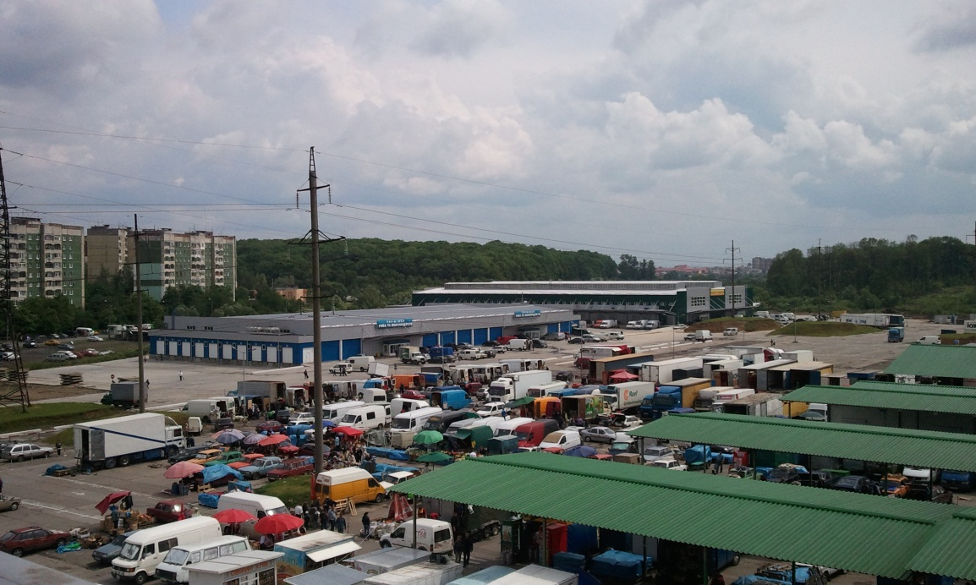
WMAP«Shuvar» Lviv
Fish & Seafood terminal:
-Working from dec. 2011
-Area- 3456 sq. m
-Assortment – more then 1000 products position
Fruits & vegetables pavilion:
-Working from dec. 2011
-Area- 4368 sq. m
-Assortment – more then 500 products position

Slide 24
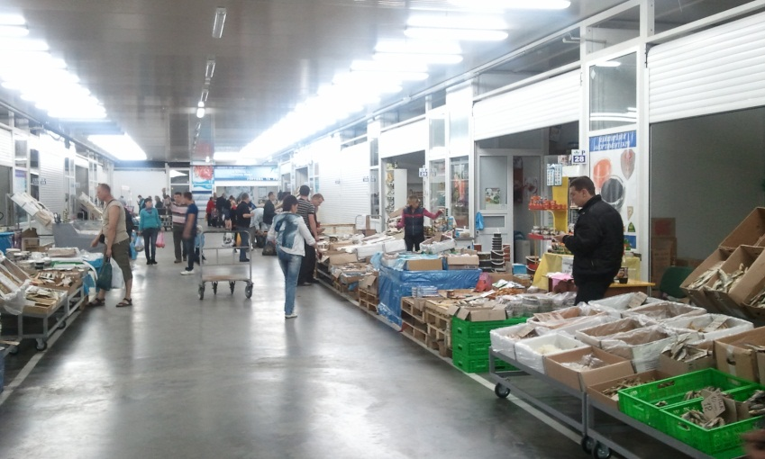
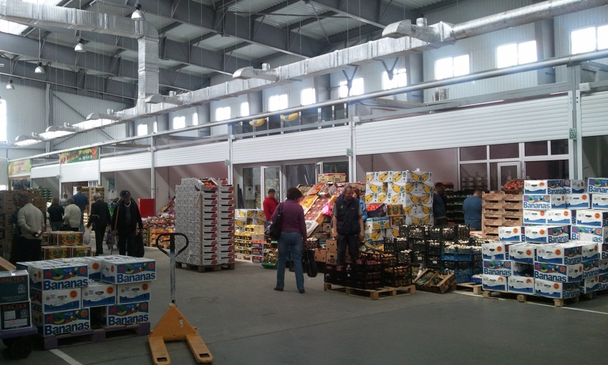
WMAP«Shuvar» Lviv

Slide 25
Projects of WMAP «Shuvar»

Slide 26
Intellectual Logistics
Consumption in region
Supermarkets
Retail markets
-Stalls
Shops “Near the house”
HoReCa
Export to the regions
on the platform WAP
“Truck train” project
Export
WMAP Shuvar
WAREHOUSE of
Ready-made
agricultural
products
Large and medium
PRODUCERS

Slide 27
Intellectual Logistics mechanism
PRODUCER
DEALER (+8-12%)
OPERATOR
BUFFER STORAGE AREA
OPERATOR

Slide 28
Intellectual Logistics Shuvar guaranty
-Increase in sales volume due to absence of lost sales (permanent product availability on shelves).
-Price decreasing for consumer with stable producers’ prices (no dealer’s mark-up).
-Product rotation increase (time diminishing on product delivery from factory to a counter).
-Acceptance and high-quality preselling products storage.
-Professional orders forming based upon actual product sales.
-Advertising and product promotion.
-Flexibility to producers’ requests.

Slide 29
Intellectual Logistics
Results, 2012 | Turnover, Euro | Turnover, tons
Meat | 510 000 | 215
Fish | 101 000 | 9,7
Fruits & vegetables | 142 000 | 244

Slide 30
Distance Sales
Consumption in region
Supermarkets
Retail markets
-Stalls
Shops “Near the house”
HoReCa
Export to the regions
on the platform WAP
“Truck train” project
Export
WMAP Shuvar
Large PRODUCERS

Slide 31
Distance Sales
The sales of producer’s product at the market by our sales staff at the price, set by producer and under his operative on-line supervision.

Slide 32
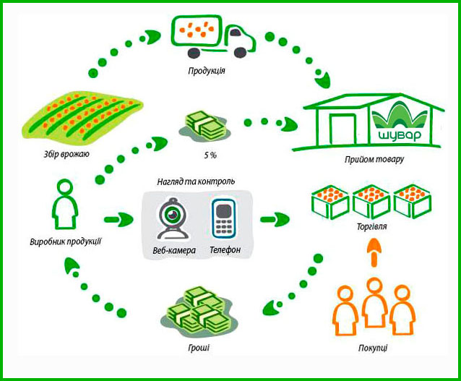
Distance Sales mechanism

Slide 33
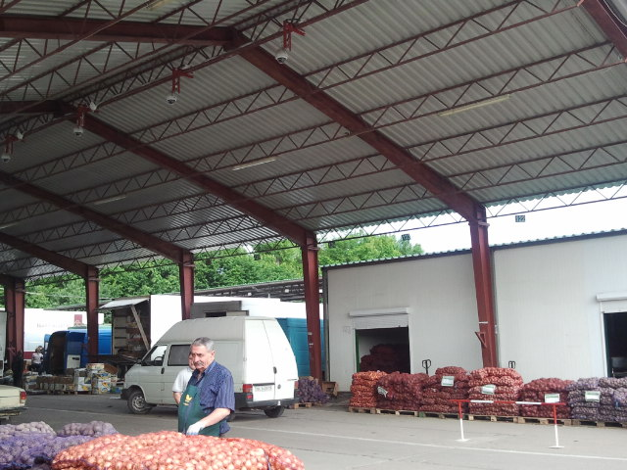
Distance Sales

Slide 34
Internet market«Shuvar»
Final consumer - active user of the Internet market
of city Lviv
WMAP Shuvar
SMALL PRODUCERS

Slide 35
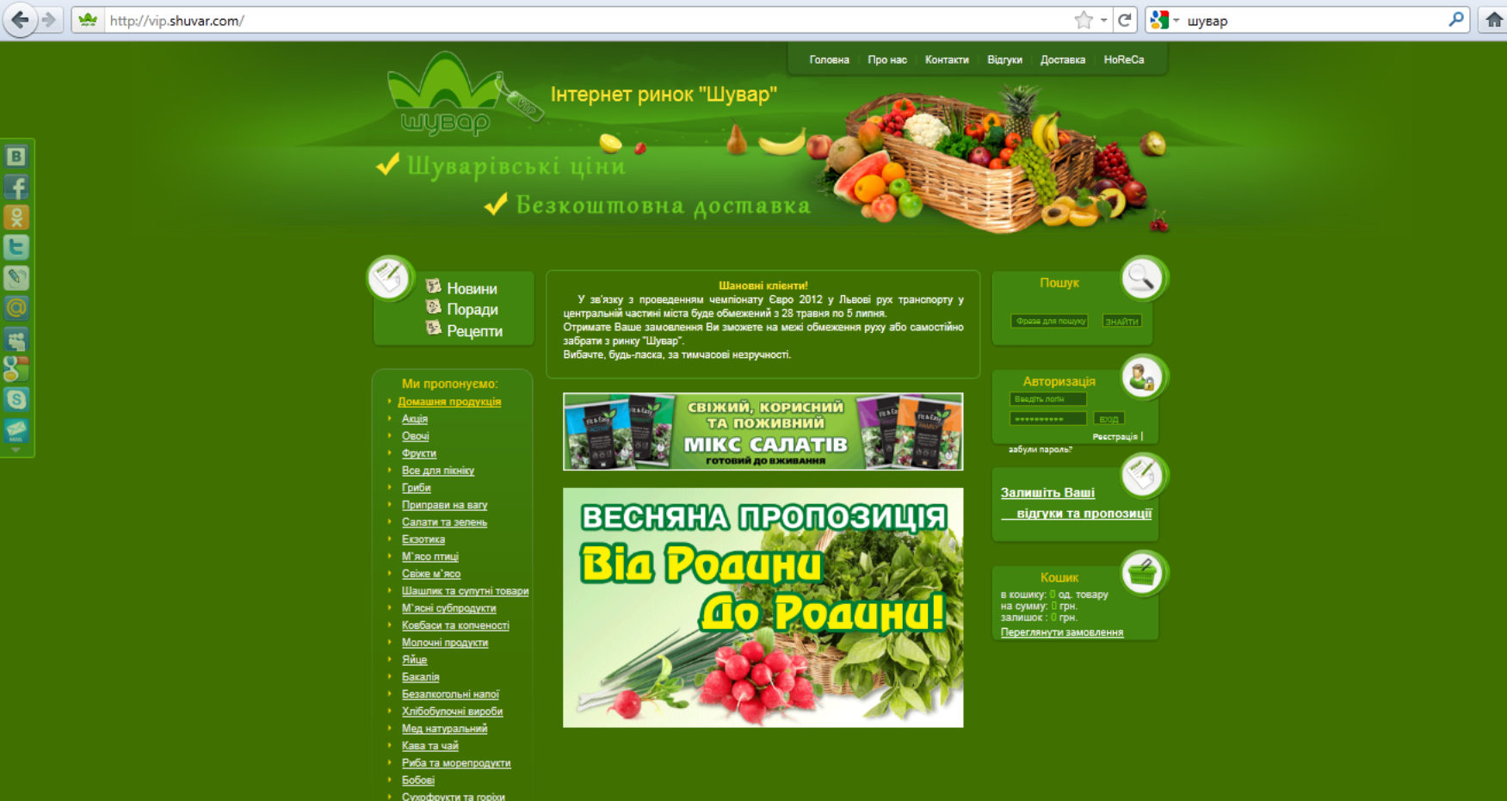
Internet market«Shuvar»

Slide 36
Internet market«Shuvar»
-Monthly quantity of orders – apr. 2150 avr.
-Quantity of registered clients – 5300
-Quantity of permanent clients – 520
-Monthly increase of clients – 320
-HORECA clients – 200
-Total number of positions – 2000
-Number of positions of homemade products - 50

Slide 37
Internet market«Shuvar» From Family to Family
In 2010 WAM “SHUVAR” started the project «From Family to Family». This project is a component part of the Internet shop «VIP service». It enables Lviv citizens to order fresh, home and environmentally clean products with direct delivery to recipient; and peasants, in the same time, can get the regular sale of the products.
Now the Project works with villages of Peremyshlyany District: Hanachivka, Korostne, Stanymyr and Lagodiv.

Slide 38
WMAP «Shuvar» - is the first market on the territory of CIS which was certified according to the standard ISO 9001

Slide 39
Thank you!

