Slide 1
The whosale’s role in contemporary Polish economy.
Dr M A Falinski

Slide 2
Basic wholesales formats in Poland
Classical wholesale in a traditional chain of delivery
Grand retailers purchase/delivery centres
Chained wholesalers:
- cash&carry
- franchise integrators
- specialized servicers
Agricultural wholesale markets
CHALLENGE – how to hold retailers with?

Slide 3
What is Polish food-wholesale market like?
Abundant: 200 B zloties in sales;
Based on domestic farming and production
(ca 90% of retail’s offer comes from Poland)
Extremely competitive: ca. 4.500 whosalers but the structure is wierd:
- c&c chains block – in retreat
- strong block of servicers and franchise integrators – in a sway
- traditional wholesales stores and local chains – subject to
consolidation or integration
Deconcentrated but… strongly concentrating verstile retail formats
CONCENTRATION – a common denominator of market evolution
PREMANENT GROWTH – and decisive role of internal market in GDP generation (>60%)

Slide 4
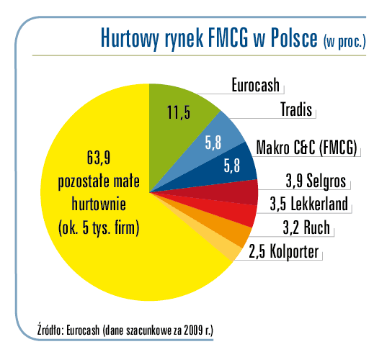
Players in numbers

Slide 5
Strategies to „chain-up” distribution markets (opportunities for potential investors)
Consolidations
- takeovers, horizontal and vertical mergers: large market of small companies in distribution
Diversifications
- Sales – yes,.. but portofolio must be enhanced
Specializations: klients, suppliers, products, categories
Optimizations: shrinking volumes, cutting costs, investing in know-how
Remarks:
Medium-size companies await partners!!!
There is a problem with feasibility expertise and communication!!!

Slide 6
Retailing counterparts
Integrated small stores: ca 30.000 in franchise, ca. 20.000 in purchasing groups and partnerships, agents – 5.000
Prospective formats: supermarkets and convenience
Problem of discounts: 2700 →4000 limit
Hypers-story: never forget them
Moving commerce: internet + 138.000 cars and trailers + direct sales

Slide 7
Stores in numbers - selected data
 | 2004 | 2007 | 2008 | 2010
Foreign cpt stores | 4350 | 6800 | 7800 | Est.9000
Average trading area | 905 mkw | 735 mkw | 812 mkw | Est. 760 mkw
Stores > 2500sqm | 480 | 580 | 690 | 760
Hypermkt>2500 +…) | Ca 180 | Ca 280 | Ca.300 | Ca.380
Supermkts 1 (400 -2500sqm) | ca5100 | Ca 6700 | Ca 7600 | Est 9000 (ca. 60% Polish capital)
Supermkts (150-400) | Ca 2600 | Ca 3100 | Ca 3400 | Ca. 4900
Duży sklep (100 –300sqm) | Ca 14.000 | Ca.17.000 | Ca.19.000 | est.21.000

Slide 8
Where and how are the agricultural markets?
They gradually substitute traditional food wholeselling (34 markets and good prospects for the future)
They offer their wholesale service on their own but absorb whosalers from outside, either (chained stores, too)
They have good competitive position
- plethora of traditional stores
- growing HOReCa
- competition more and more leant on quality and short delivery chains
- franchised stores, despite integration, are obliged to sell „greens” as fresh as possible
- eco, regional, bio, other extra-marked stores are in sway
- chains by definition have problem with „very fresh” assortments (big scale does not favor these categories)
- time to start retail integration is comming up (specialized stores, collonial goods, etc):
deconcentration of suppliers raise the first problem but the second one is…
– create own retail recipients (franchise within joint ventures?)
- regional (CEE) markets need sourcing services and logistical storage facilities
- farmers and importers need cross-docking facilities
REMARK: information + promotion + investments support (PPP+EU funds); regional initiatives endowed with guaranties

Slide 9
Polish specifics: a resume’
Think East – act and exist West
Flexibility of wholesale and retail (strategies and formats)
Traditional trading is effective and integrated (market penetrability – think thoroughly, sell locally)
Flexibility of formats/wide fan of choice for suppliers
Specific stage of market modernization: get integrated or die
Assortments refurbish: permanent chance to be taken by new suppliers
Sales supporting is necessary
Competitive market-game: be different of disapear

Slide 10
The addenda…
Representation and communication is lame!!!
Policy vis a vis region is necessary: tangible instruments instead of declarations
Institution to suppoert cooperation is needed
(PAIIZ for FMCG?... Or anything else; better
business than office)
…. Questions and motions are wellcome

