Slide 1
Trade in agricultural and food products – Republic of Serbia
Prof. Dr. Vlade Zarić
Univerzitet u Beogradu - Poljoprivredni fakultet
vzaric@agrif.bg.ac.rs

Slide 2
Content:
Importance of the agricultural and food sector
Trade
Serbia food = Serbian Brand ?

Slide 3
Importance / Structure
Contribution to the GDP / Structure
Employment and rural development
Export
Brand

Slide 4
Importance / Structure
Agricultural production
70% crop production
30% animal production.

Slide 5
Importance / Structure
Crop production
Changeable areas and yields => Volume
Low average yields
Larger number of semi-substantive farms
Product quality!

Slide 6
Importance / Structure
Animal production
Decreasing production volume
Decreasing cattle number
Export of baby beef ...
Small number of companies that could export meat to the EU (products treated under high temperature) and just one dairy

Slide 7
Importance / Structure
Food industry – Strengths
Wide range of inputs made in Serbia
Market position in the region – good reputation
High investment in the sector - foreign and Serbian companies
Privatisation process almost completed
Investments in new products – confectioned of meat and berries
Increasing product quality!

Slide 8
Importance / Structure
Food industry – Weaknesses
Obsolete technology
Low level of capacity use => Cost ↑
Some branches are not developed => problems for the advanced companies!
SME face organizations and managerial problems – growth barriers!

Slide 9
Importance / Structure
Conclusion the sector:
Moderate sector efficiency and competitiveness especially on the international markets.

Slide 10
Trade
Increasing export and import and positive trade balance

Slide 11
Trade
But …
Not favorable export structure
75 % agricultural products
25 % food

Slide 12
Trade
Import
65 % agricultural products
30 % food
5 % fish

Slide 13
Trade
Trade partners
EU
CEFTA
EFTA
Bilateral agreements – Russia, Belarus, Kazakhstan, – Turkey, USA

Slide 14
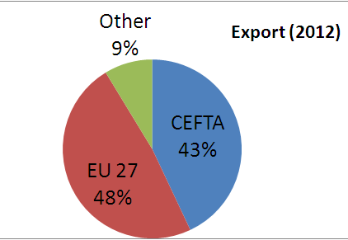
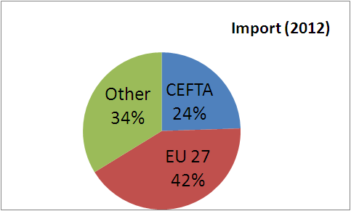
Trade

Slide 15
Trade – EU the major trade partner
Average of trade volume (2005-2010) 958 mil. €
Average surplus (2005 –2010) 183 mil. €
Trade max (2010) 1,180 mil. €
Export max (2010) 821 mil. €
Surplus 462 mil. €
Import max (2008) 465 mil €
In 2010 in comparison to 2005, export increased by 97%and import by 11 % => surplus 4,9 times.

Slide 16
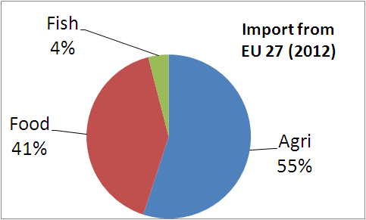
Trade – EU the major trade partner, But ...
Export of primary products (94 %)
Food product (6 % export and 41 % import
food trade deficit is 6 time of export value
UV Export € / kg (0,73 – 0,82)
UV Import € / kg (2,4 1– 2,70)
=> price competitive products!
Quality !
Technology !

Slide 17
Trade – EU the major trade partner – EU
Low added value of – row material and semi manufactured products
Leading export products are crops and not animal products
The main trade partners in export are Germany, Austria, Italy
In import from EU prevail products with high technology content
The main trade partners in export are Germany, Austria, Greece

Slide 18
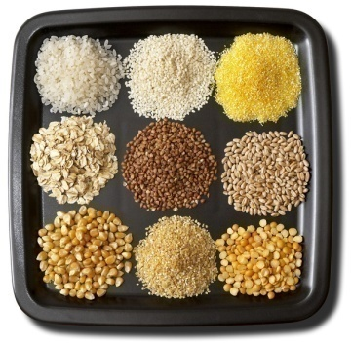
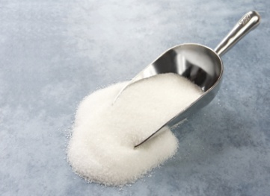
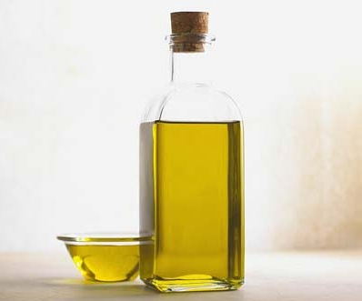
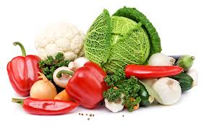
Trade – Top 5 products group
Export
Cereals
Fruits – frozen
Sugar and sugar based products
Fat and oil
Vegetables
Import
Food and food supplement
Fruits
Cocoa
Products based on cereals
Fat and oil

Slide 19
Trade
Conclusion the trade:
Increasing export dominated by products that are price competitive!

Slide 20
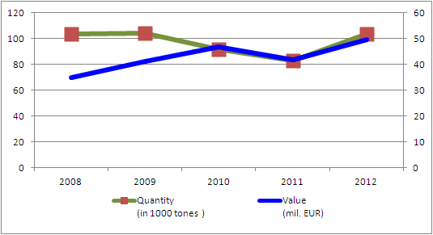
Trade – wholesale
Quantity – stable
Value – calculation method (estimation – quantity, quality, hours price movement)!

Slide 21
Trade – wholesale

Slide 22
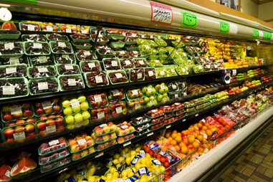
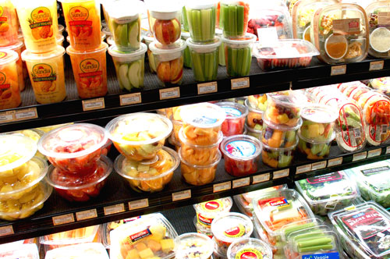
How to make a brand?

Slide 23
Brands

Slide 24
Serbia

Slide 25
Small producers in Serbia!

Slide 26
Thanks ! ! !

