Slide 1
Influence of Warsaw Bronisze Wholesale Market on competitiveness of horticultural production in central Poland
Belgrade ,8 April, 2013

Slide 2
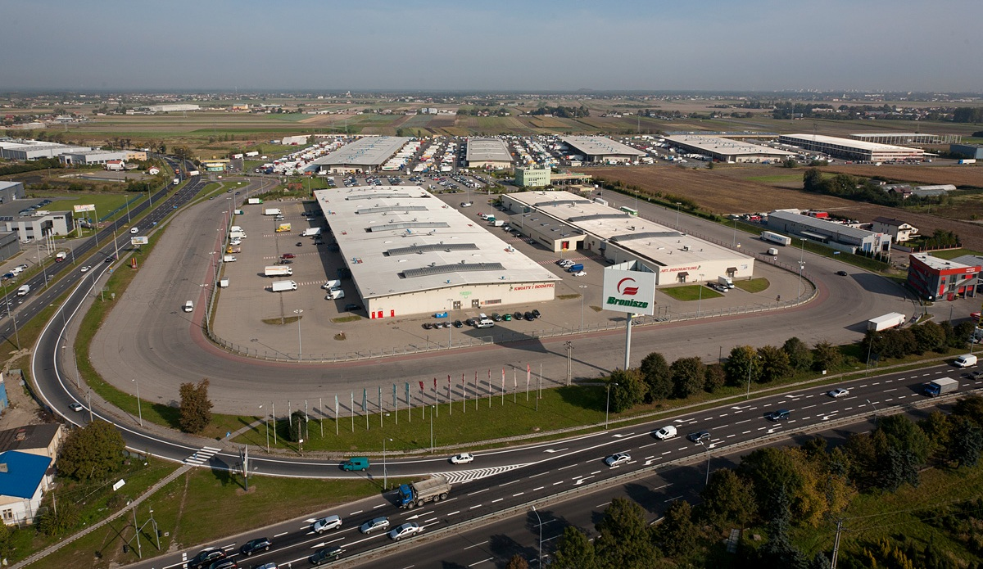
Warsaw Bronisze WM – General view

Slide 3
Characteristics of the Warsaw Bronisze WM
Producers
Importers
Primary markets
Wholesalers
Retailers
Suppliers
Exporters
Other markets
Direct linking of demand and supply
Completion of deliveries
Sorting
Packing
Agency services
Insurance
State
Inspections
Bank
Transport
Customs Clearance
Packaging
Direct contacts

Slide 4
Bronisze WM – Key figures
Total area – 51.6 ha
Number of trade places in open area – 1282
Average daily number of entries of Buyers – 2777
Estimated annual turnover – app.1,200,000 t
Number of long-term tenants in trade areas – 470
Area in halls and roofed facilities – 8.5 ha
Revenue (from space rental) in 2012 – PLN 48.0 million / Euro 12.0 million
Average daily number of entries of Sellers – 998

Slide 5
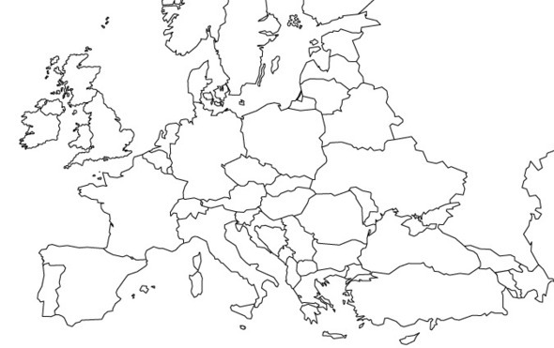
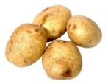
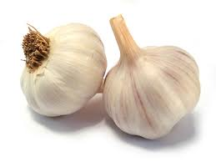
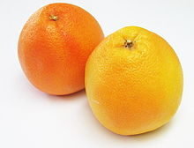
Bronisze WM - Sourcing directions
29,000 suppliers/ producers offer a full product range in terms of species and varieties of fruit and vegetables produced in Poland
470 wholesalers take care of a full offer of imported fruit and vegetables meeting the customers’ expectations
Central America
Central America
Central America
Florida
China
Chile, South Africa
Chile

Slide 6
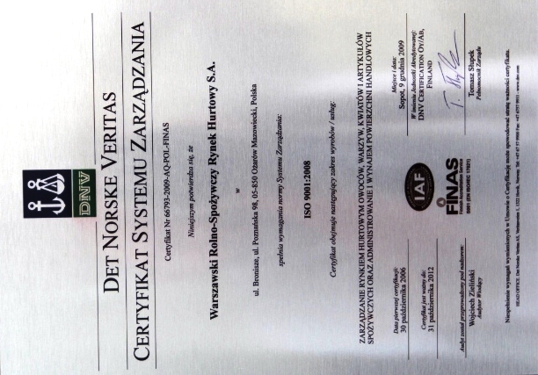
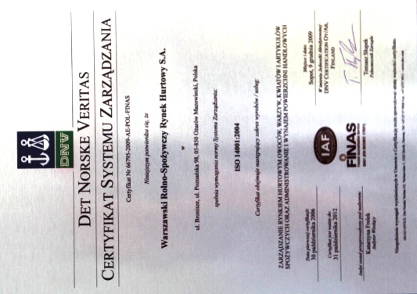
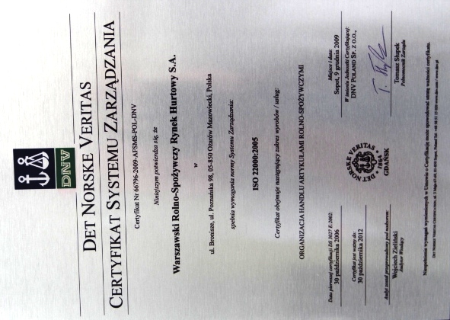
Focus on product quality
ISO 9001:2008 certificate - Management of a Wholesale Market of fruit, vegetables, flowers and food products and rental of trade space
Management system - ISO 22000:2005 standard - Organization of trade in agricultural and food products/ food safety
ISO 14001:2004 standard – Management of a Wholesale Market of fruit, vegetables, flowers and food products, administration and rental of trade space

Slide 7
Company marketing goals in 2013
Detailed analysis of business processes in services offered by the Market and their adjustment to changing needs and expectations of our Clients to ensure generation of profits
Increase of the market share by means of new services provided to our Clients, which with the support from active marketing operations, will make it possible to retain the existing Clients and acquire new ones
Development of stronger relations between the Company and the Clients, and in particular building a system of customer loyalty to the Warsaw Bronisze Wholesale Market
Attracting new Clients by ensuring the provision of innovative, better quality services to them

Slide 8
Marketing goals - Implementation
Consolidation of Clients around the Market
Sellers
Buyers
Development of a better loyalty system to retain the existing Clients and to attract new ones
Strengthening of the Bronisze Market role as the centre of education and trade information
Building the Company image as a business engaged in promotion of a healthy lifestyle based on physical activity and a diet rich in fresh fruit and vegetables

Slide 9
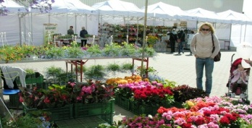
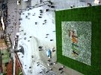
Marketing – Bronisze Market as a business support centre
Presentations, workshops
Sponsoring, advertising
Publications
Industry fairs, exhibitions, events
Local fairs, promotions

Slide 10
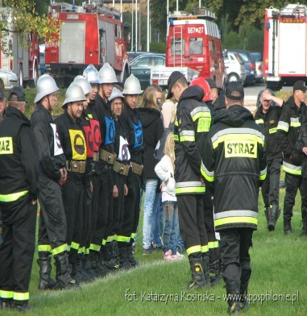
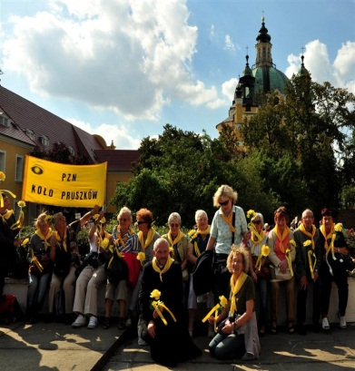
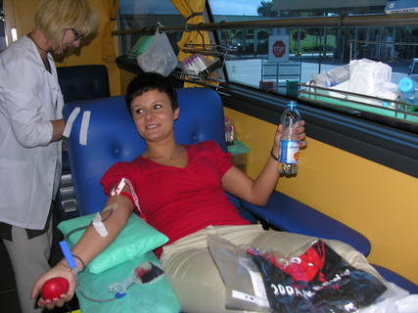
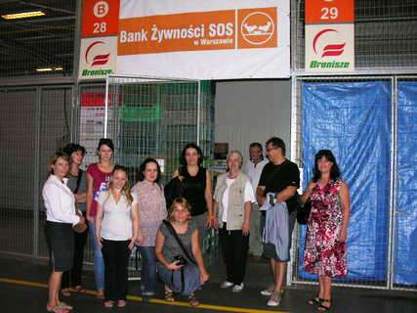
Bronisze Market – Corporate Social Responsibility
We carry out non-profit blood donor actions
We support local sports activities
We help local communities
We collect food for the people in need
We take care of the blind people community

Slide 11
Strengthening of competitiveness of Buyers
Increased stabilisation of prices
Variety of offered products – making it possible to meet the customers’ tastes
Product availability – due to the attractive trade offer, a large number of businesses offering the products, and the Market opening hours
Product quality – direct suppliers (producers, wholesalers)
Professionalism – professional experts, who know their business very well, operate in the Market

Slide 12
Strengthening of competitiveness of Sellers
Equal access to the Market, irrespectively of the production volume
Offering high quality due to maximum shortening of the time „from field to fork”
Improvement of quality of the products offered and an opportunity to compare them with products from large-scale farms and imported products
Access to the current market information, training, workshops
Decrease of the number of intermediary steps in trade

Slide 13
Thank you for your attention

