Slide 1
Wholesale Market Zagreb
Croatia
April, 2013

Slide 2
Founding and development
Wholesale Market and Cold Storages were built in the eastern part of Zagreb in 1958.
Food industry compound includes two main facilities:
Wholesale Market with a surface of 9,000 m²
Cold Storages with a surface of 5,500 m²
Today total area of WM is 72.469 m²
WM area 19.265 m²
39 boxes
19 storages
Cold storage utillities and warehouses 15.475 m²
30 separete coling storages
Plus Warehouses and other utilites
Parking area 8.600 m²

Slide 3
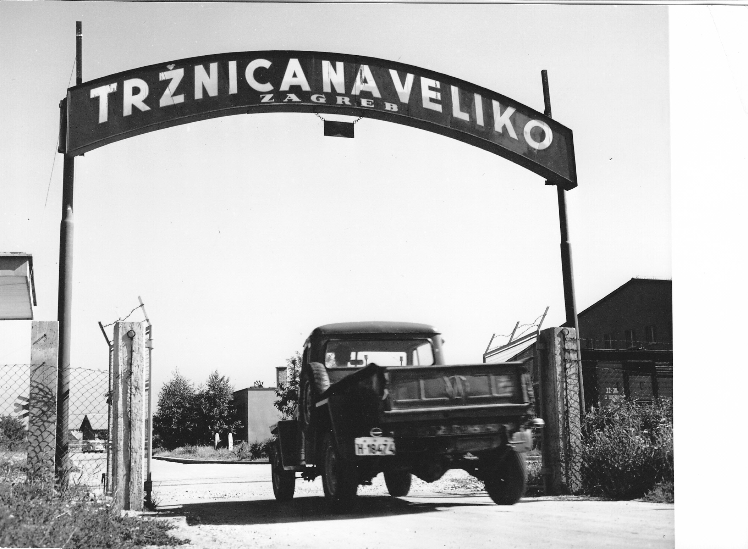
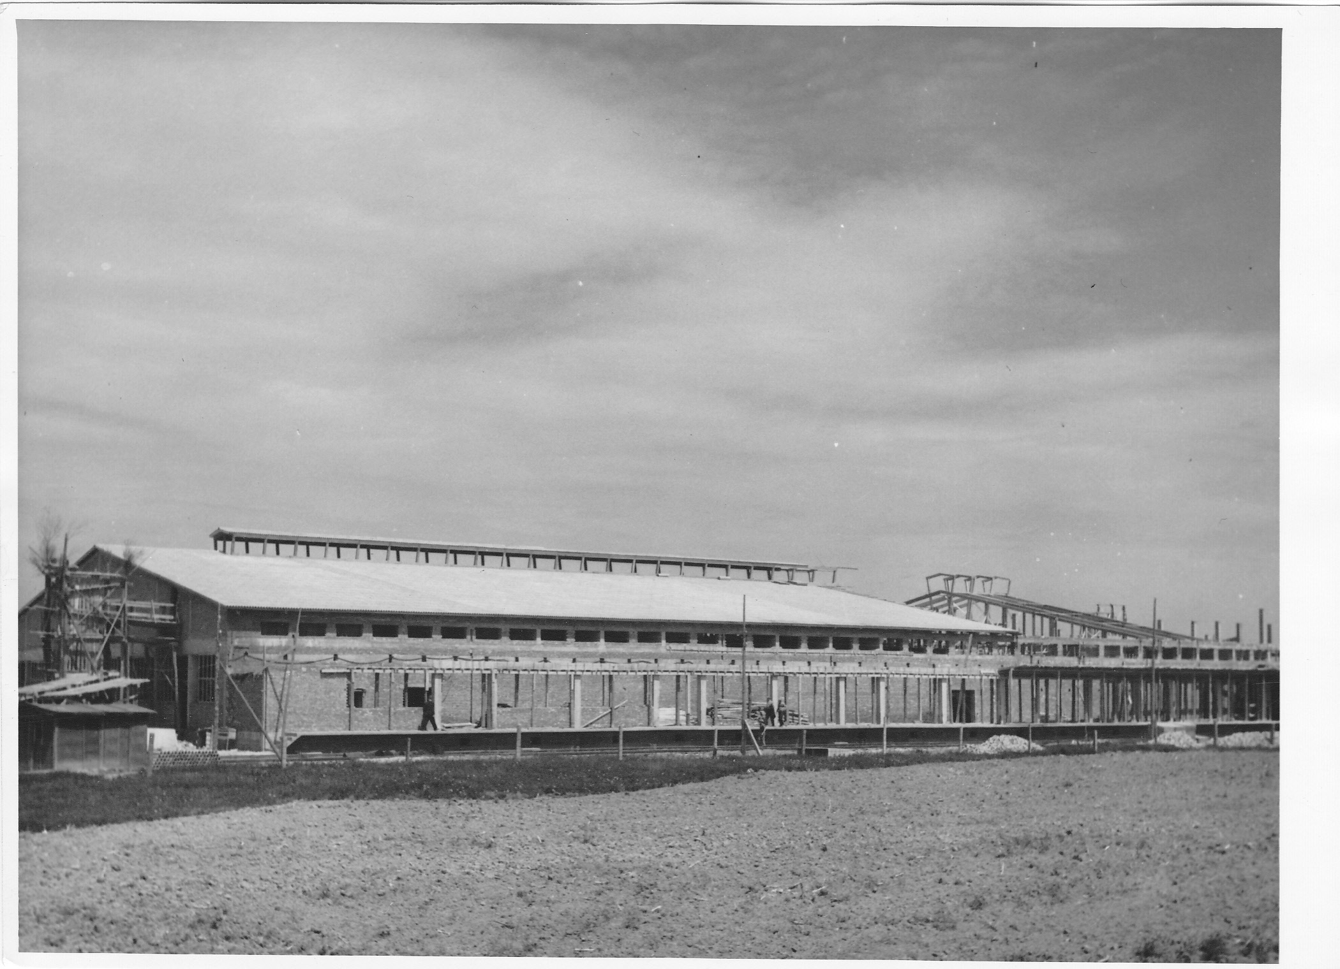

Slide 4
Wholesale Market and Cold Storages today

Slide 5
Wholesale Market and Cold Storages today
Since 20 May 2007, Wholesale Market and Cold Storages have been the organizational unit of Zagreb Markets within Zagreb Holding
Zagreb Holding d.o.o., are managing city utilities, and it consists 18 branches and 5 independent trading companys (limited liability companys)
Branch Zagreb Markets currently manages with:
23 Markets,
Wholesale market,
Green market

Slide 6
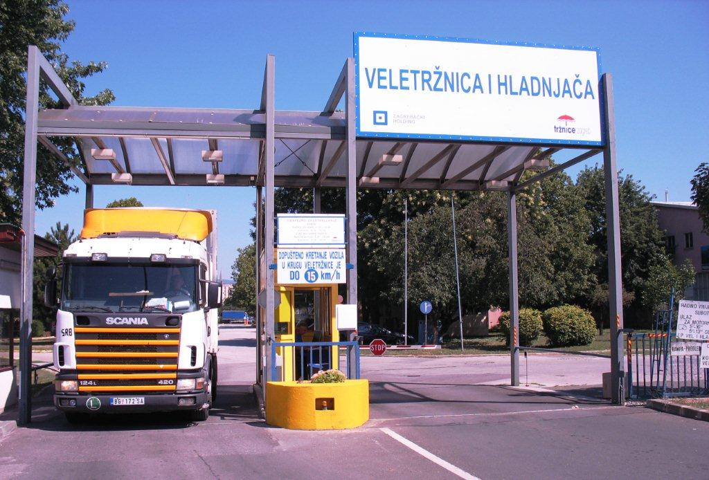
Wholesale Market and Cold Storages today

Slide 7
Businesses 2009 – 2013
01 July 2013 – Croatia becomes a member state of European Union - the process of adjustment according to European regulations requires investments
To meet the EU standards until now we invested 3 million €
To fullfill the plan we will invest another 1.5 million € by the end of this year
At the moment, the area of Wholesale Market is full – more space is indispensable
Cold Storage area – there are empty spaces, business is oscillating

Slide 8
Businesses 2009 – 2013
In the same period, business suffered serious losses
Decrease of income because of
global economic crisis
Law on fiscalization - regulation of business with cash
Loss of customers and therefore progressive loss of income because of the inability to adapt to the demands of fiscalization are expected
Most of losses of income are expected on Green and Retail markets – most of business is done in cash
From the Law of fiskalization producers are excluded

